Slide 1
Fundamentals of Software Project Management (FSPM)
Instructor: Dr. Abdul Aziz(Assistant Professor)
(School of Computing)
National University- FAST (KHI Campus)

Slide 2
Week 3

Slide 3
Initiating Process Group (IPG)
“ Journey of a thousand miles must begins with the first step”
Objectives of the Initiating Process Group:
Clarify the reason for the project.
The Business needs.
Scope of the project at high level.
Documents developed in this project.
Stakeholders.
Is this project a right choice to meet the expectations along with the reasons.

Slide 4
Activities of the IPG
Selection of PM
Documenting the business Requirements and needs
Feasibility study
Choose the alternatives
Identify the sponsor
PM
Stakeholders
Sponsor

Slide 5
Integration Management

Slide 6
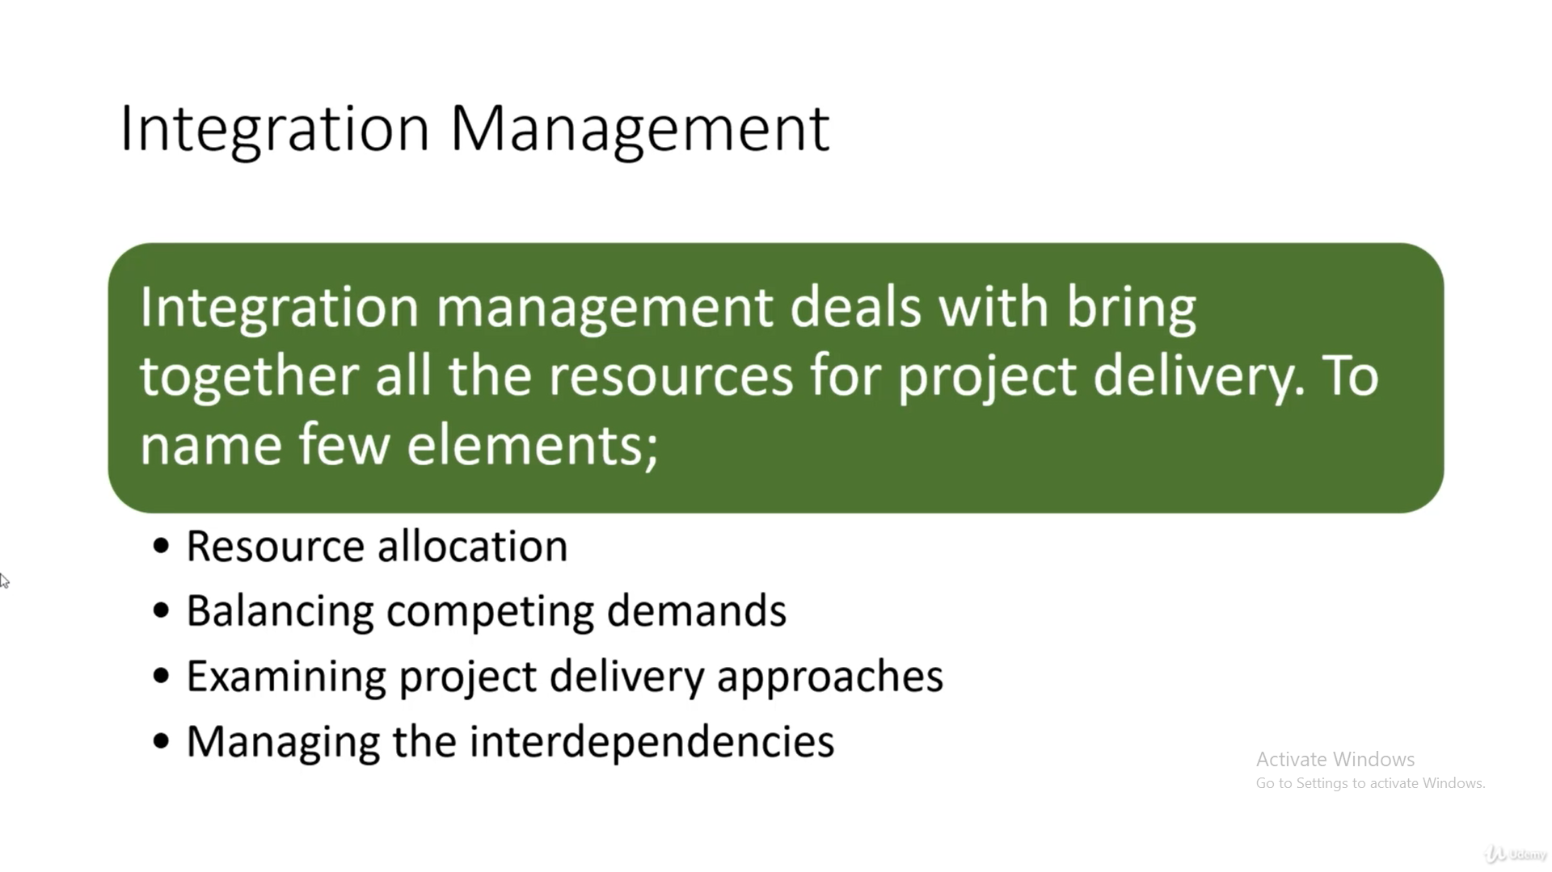

Slide 7
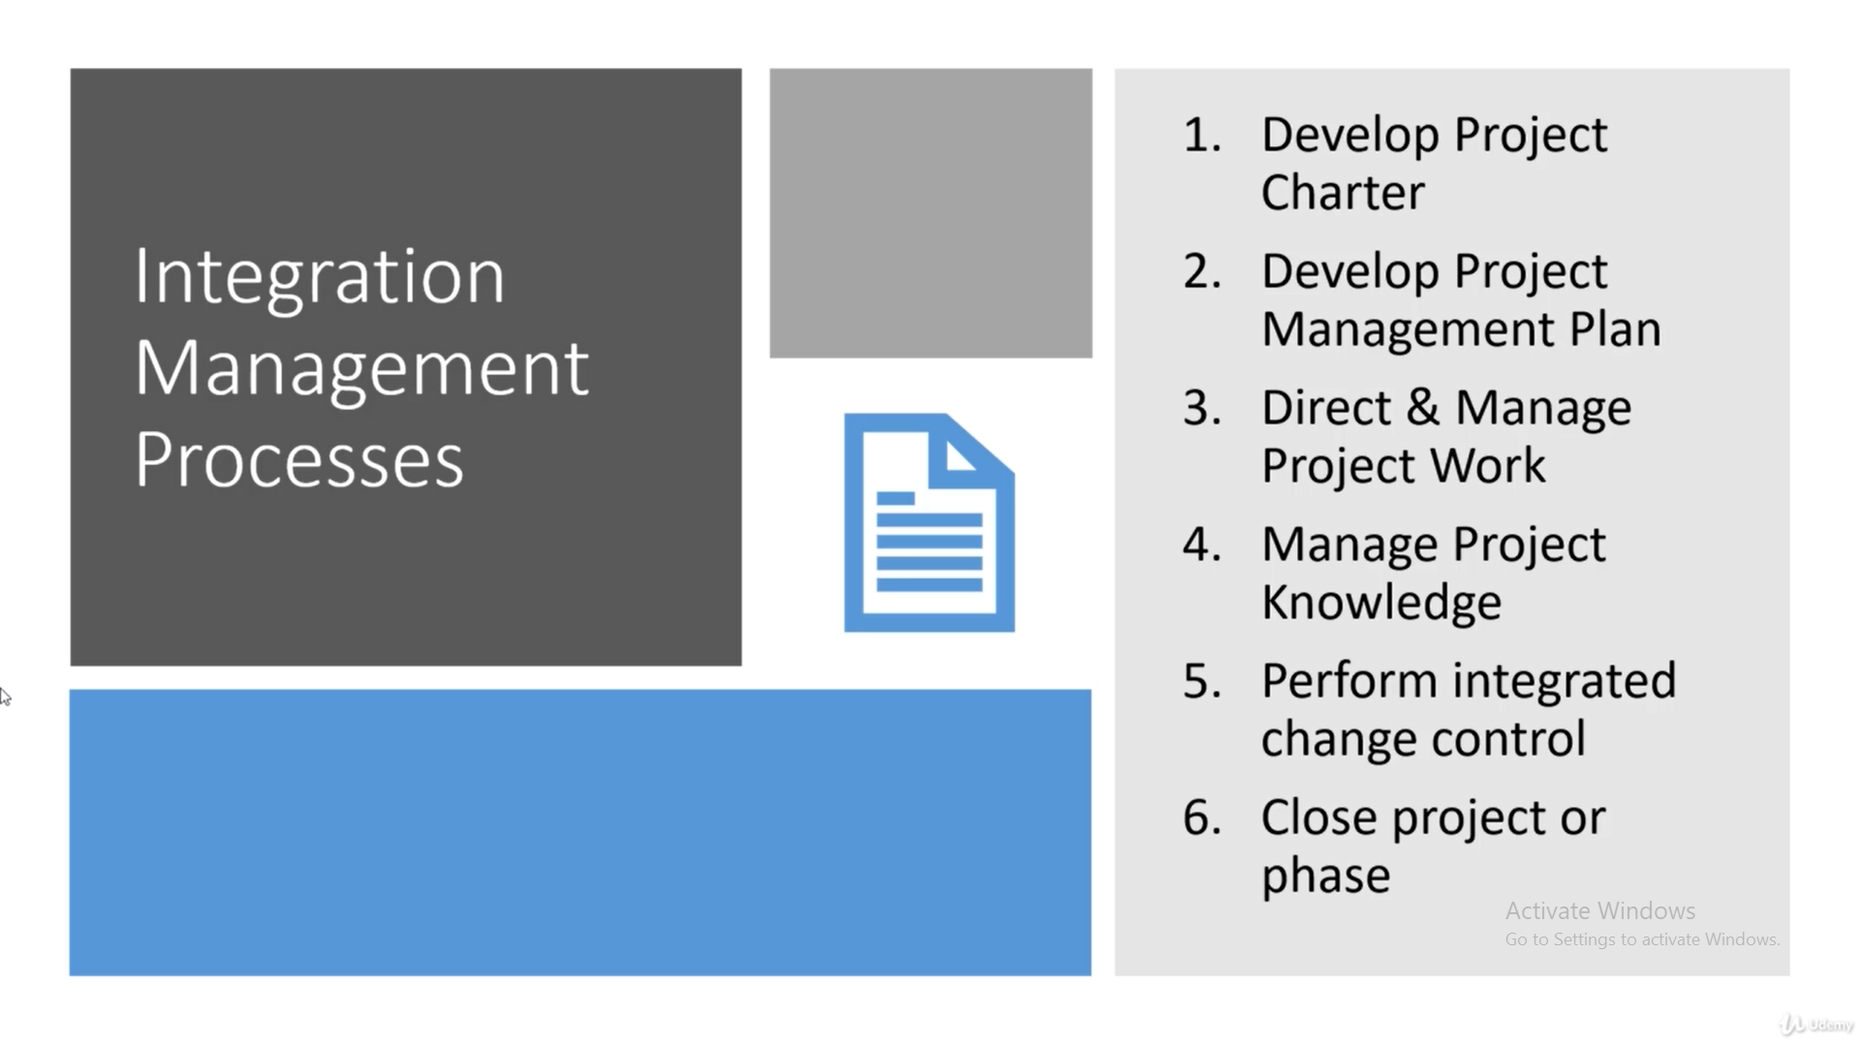

Slide 8
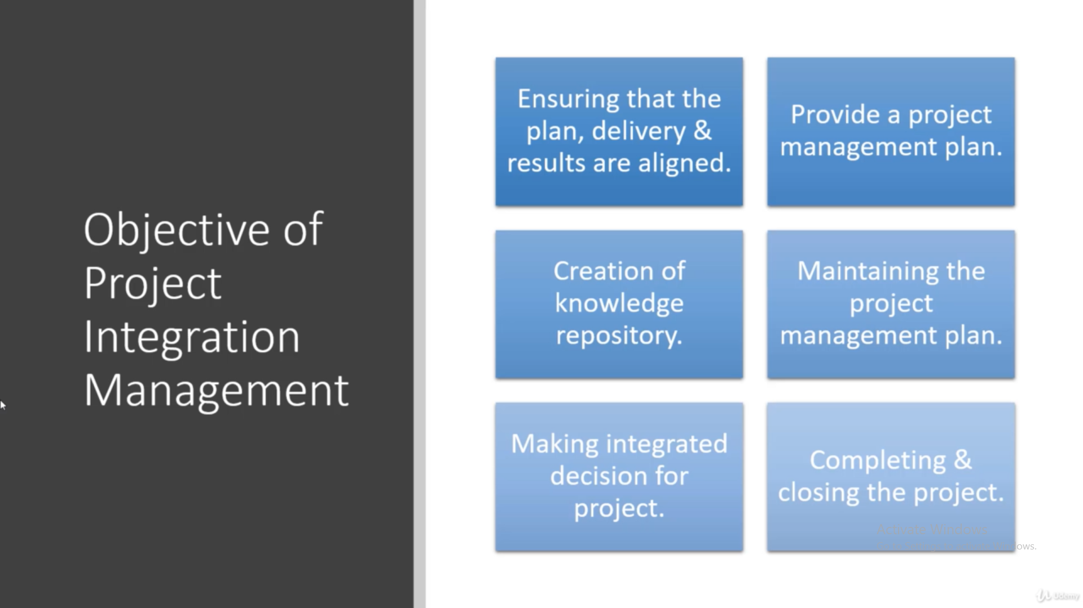

Slide 9
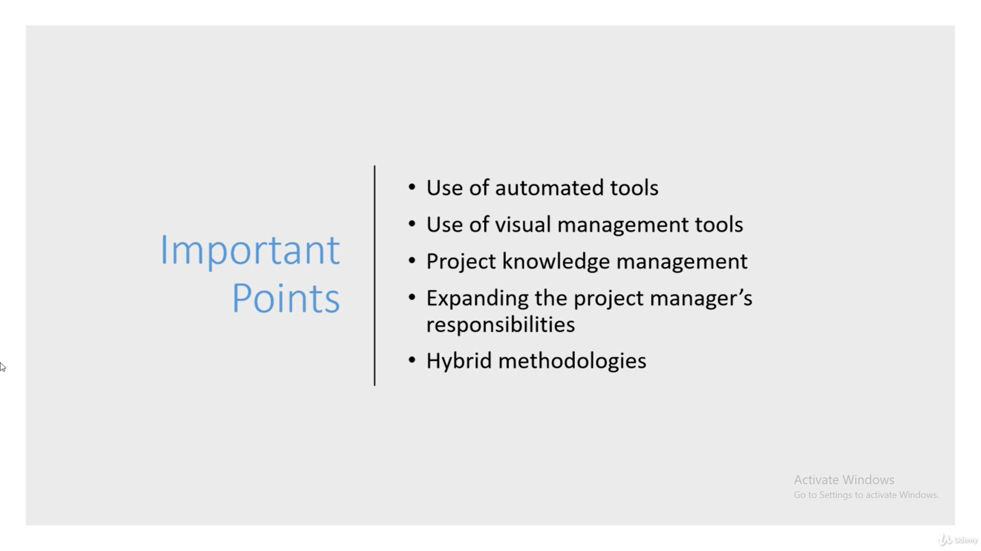

Slide 10
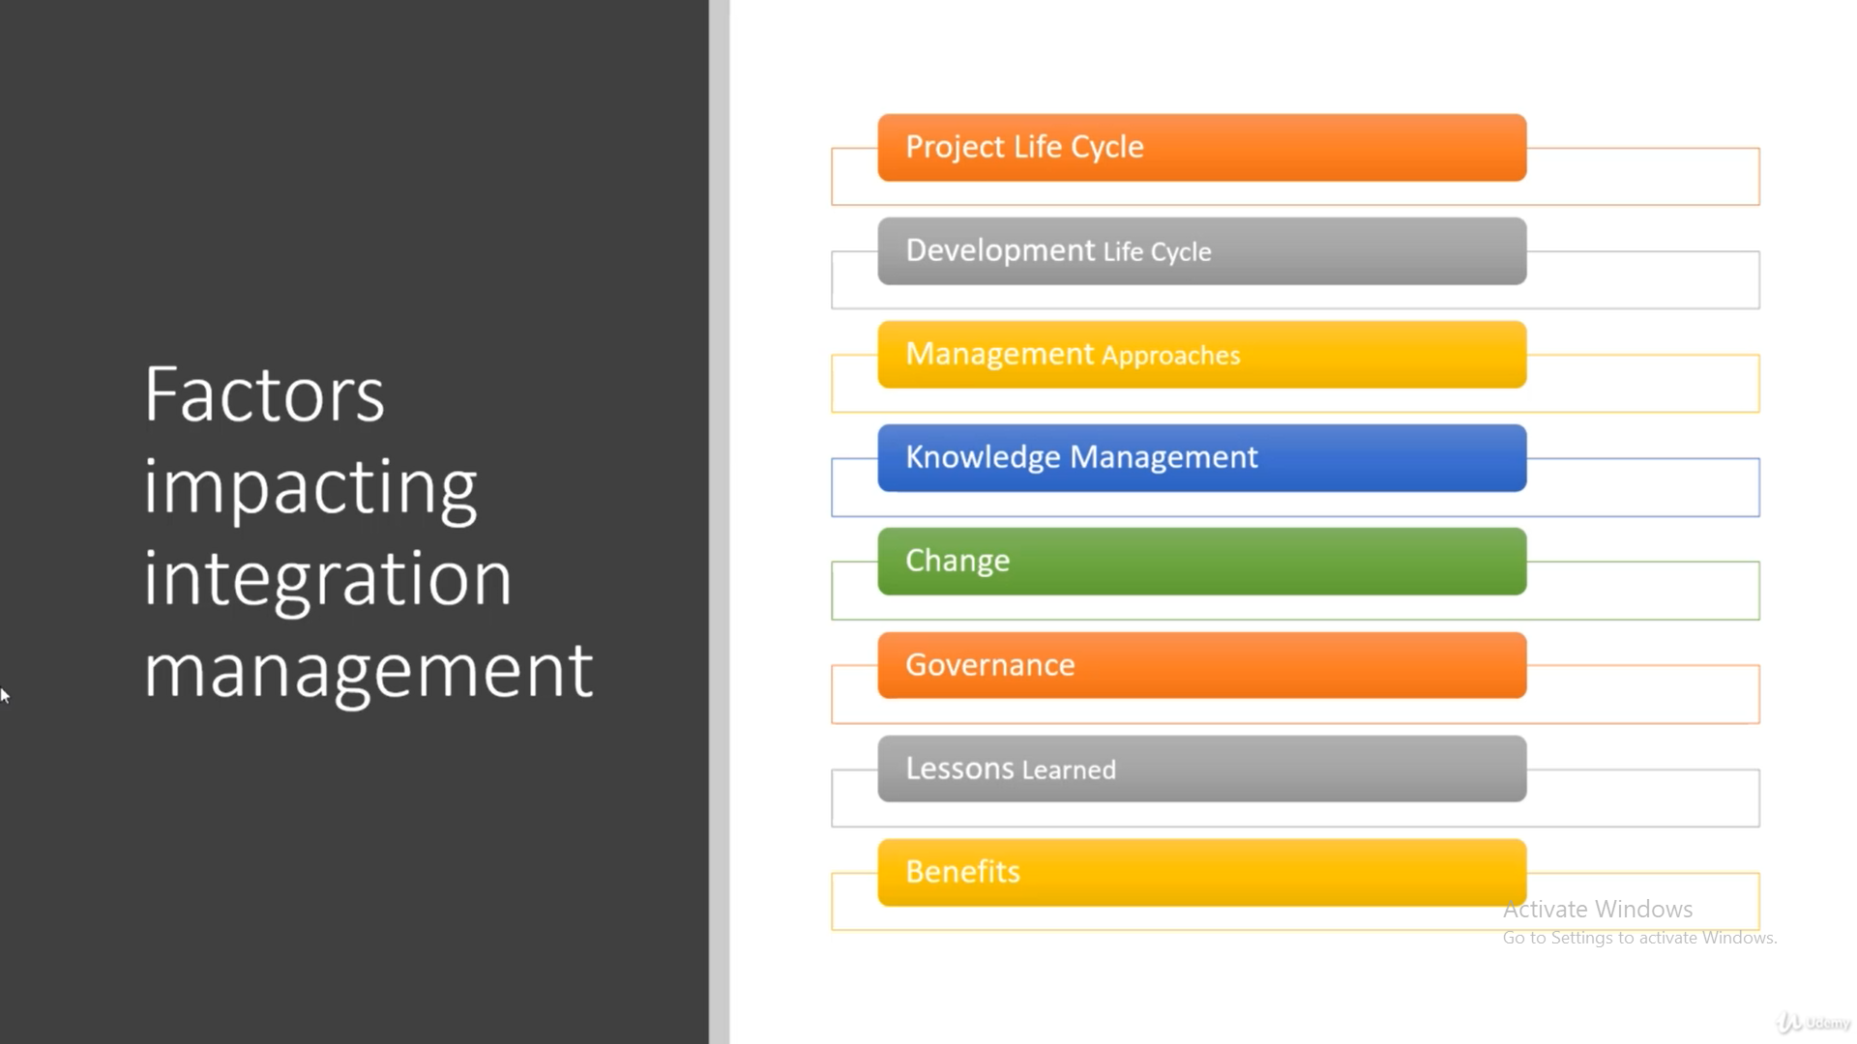

Slide 11
Project Charter

Slide 12
Project Charter
First Document in the PM.
How, who and why it is needed.
Without a PC a PM cannot initiate a project.
No PC no project exists.
It is the approval to the PM to start a project.

Slide 13
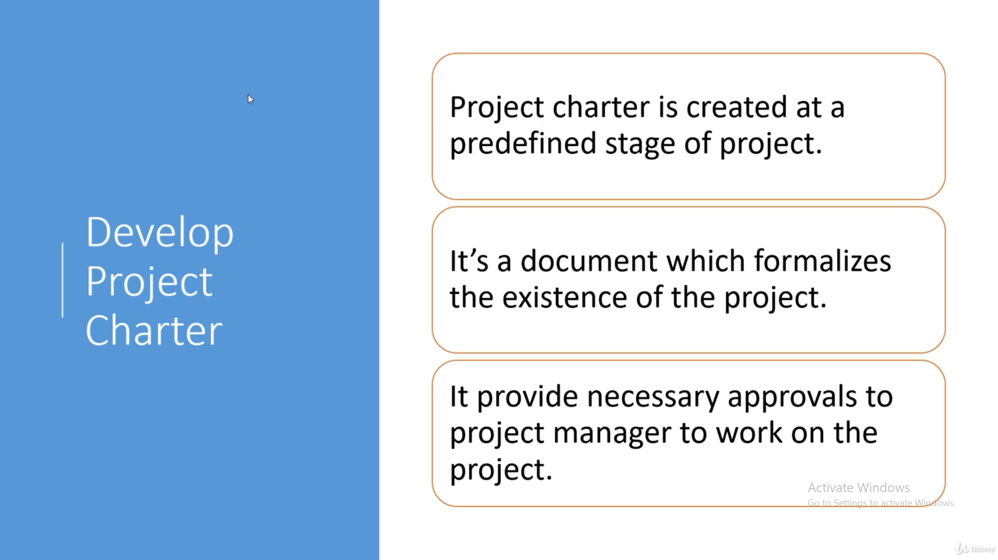

Slide 14
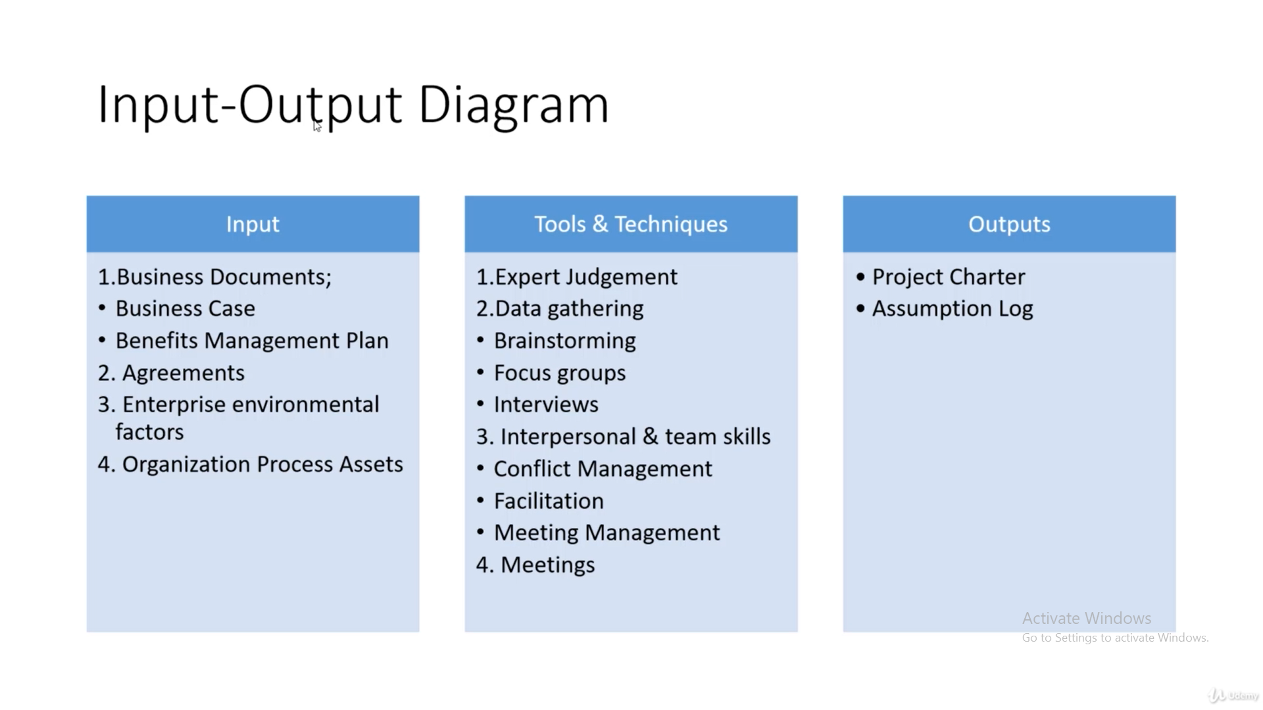

Slide 15
General Layout
A. Project purpose or justification
B. Measurable Project Objectives and related success criteria.
C. High level requirements
D. Assumptions
E. Constraints
F. High level risks and opportunities
G. Project Milestones
H. Budget

Slide 16
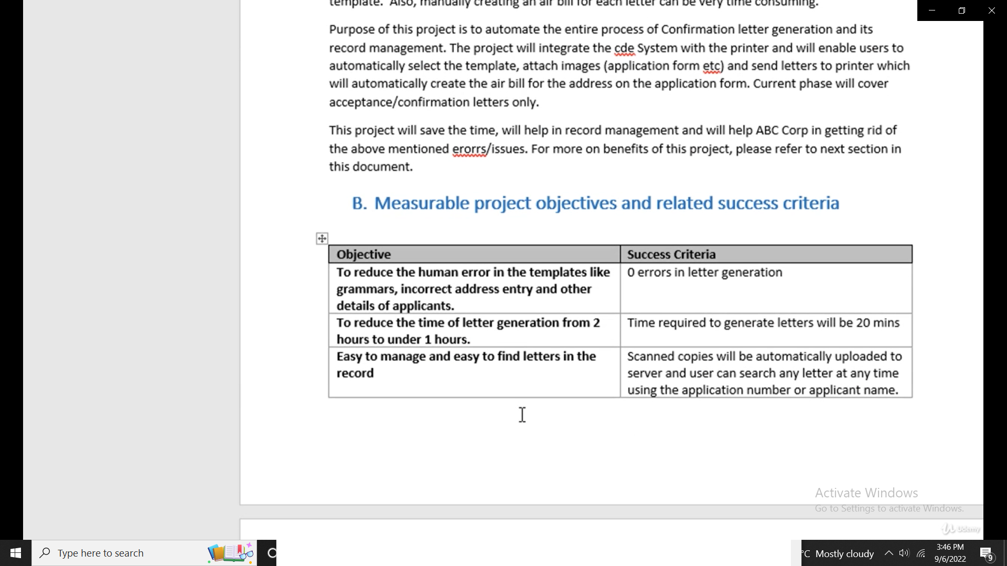
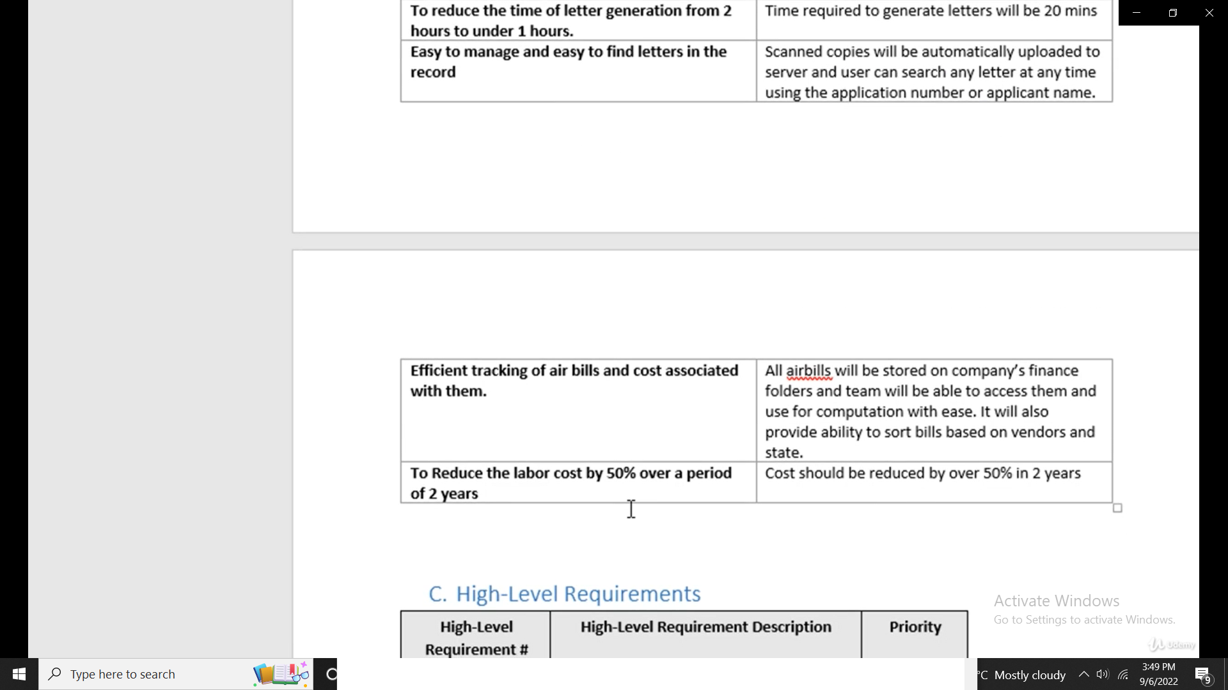

Slide 17
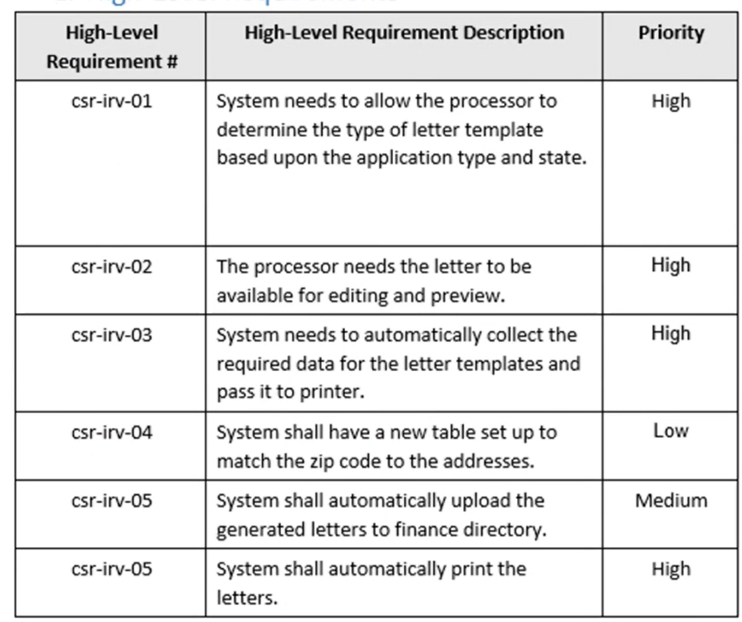
C. High Level Requirements

Slide 18
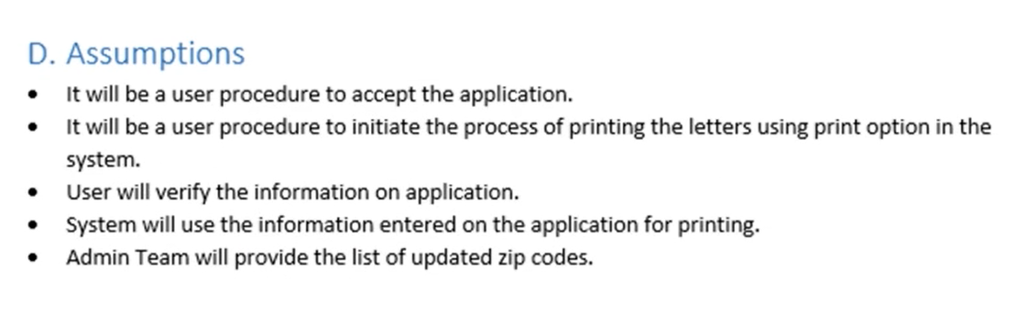
D. Assumptions

Slide 19
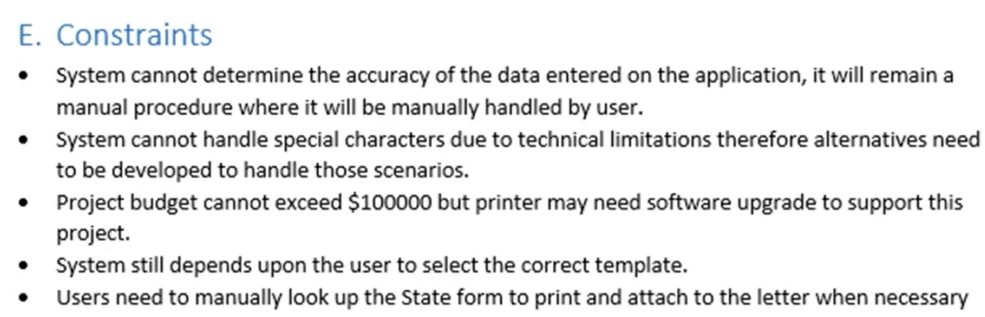
E. Constraints

Slide 20
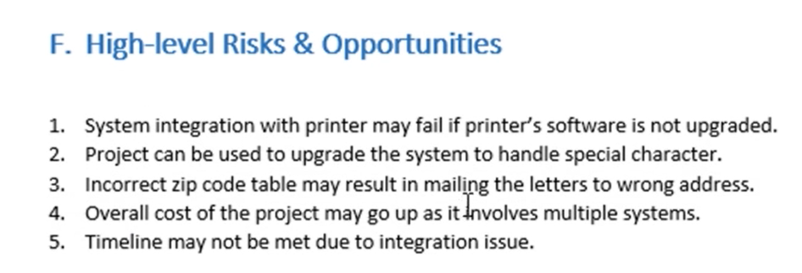
F. High level risks and opportunities

Slide 21
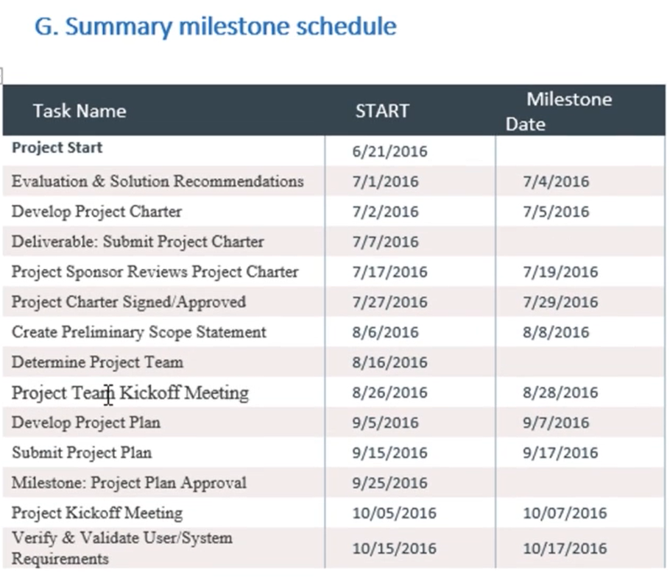

Slide 22
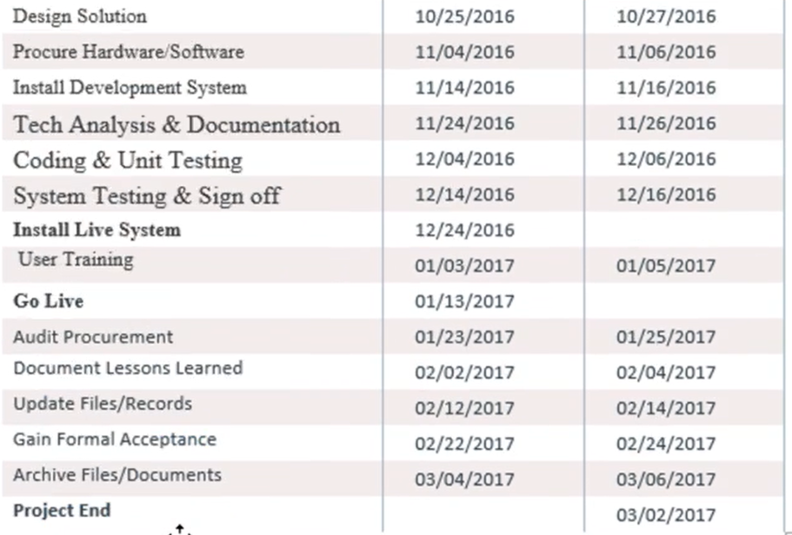

Slide 23
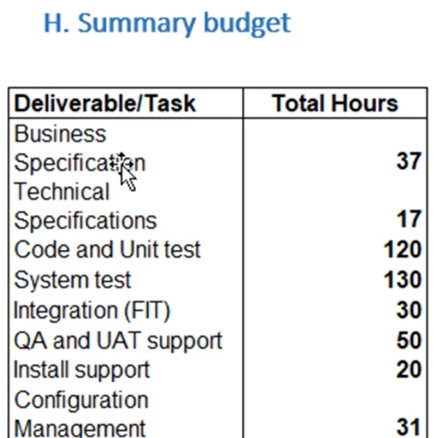

Slide 24
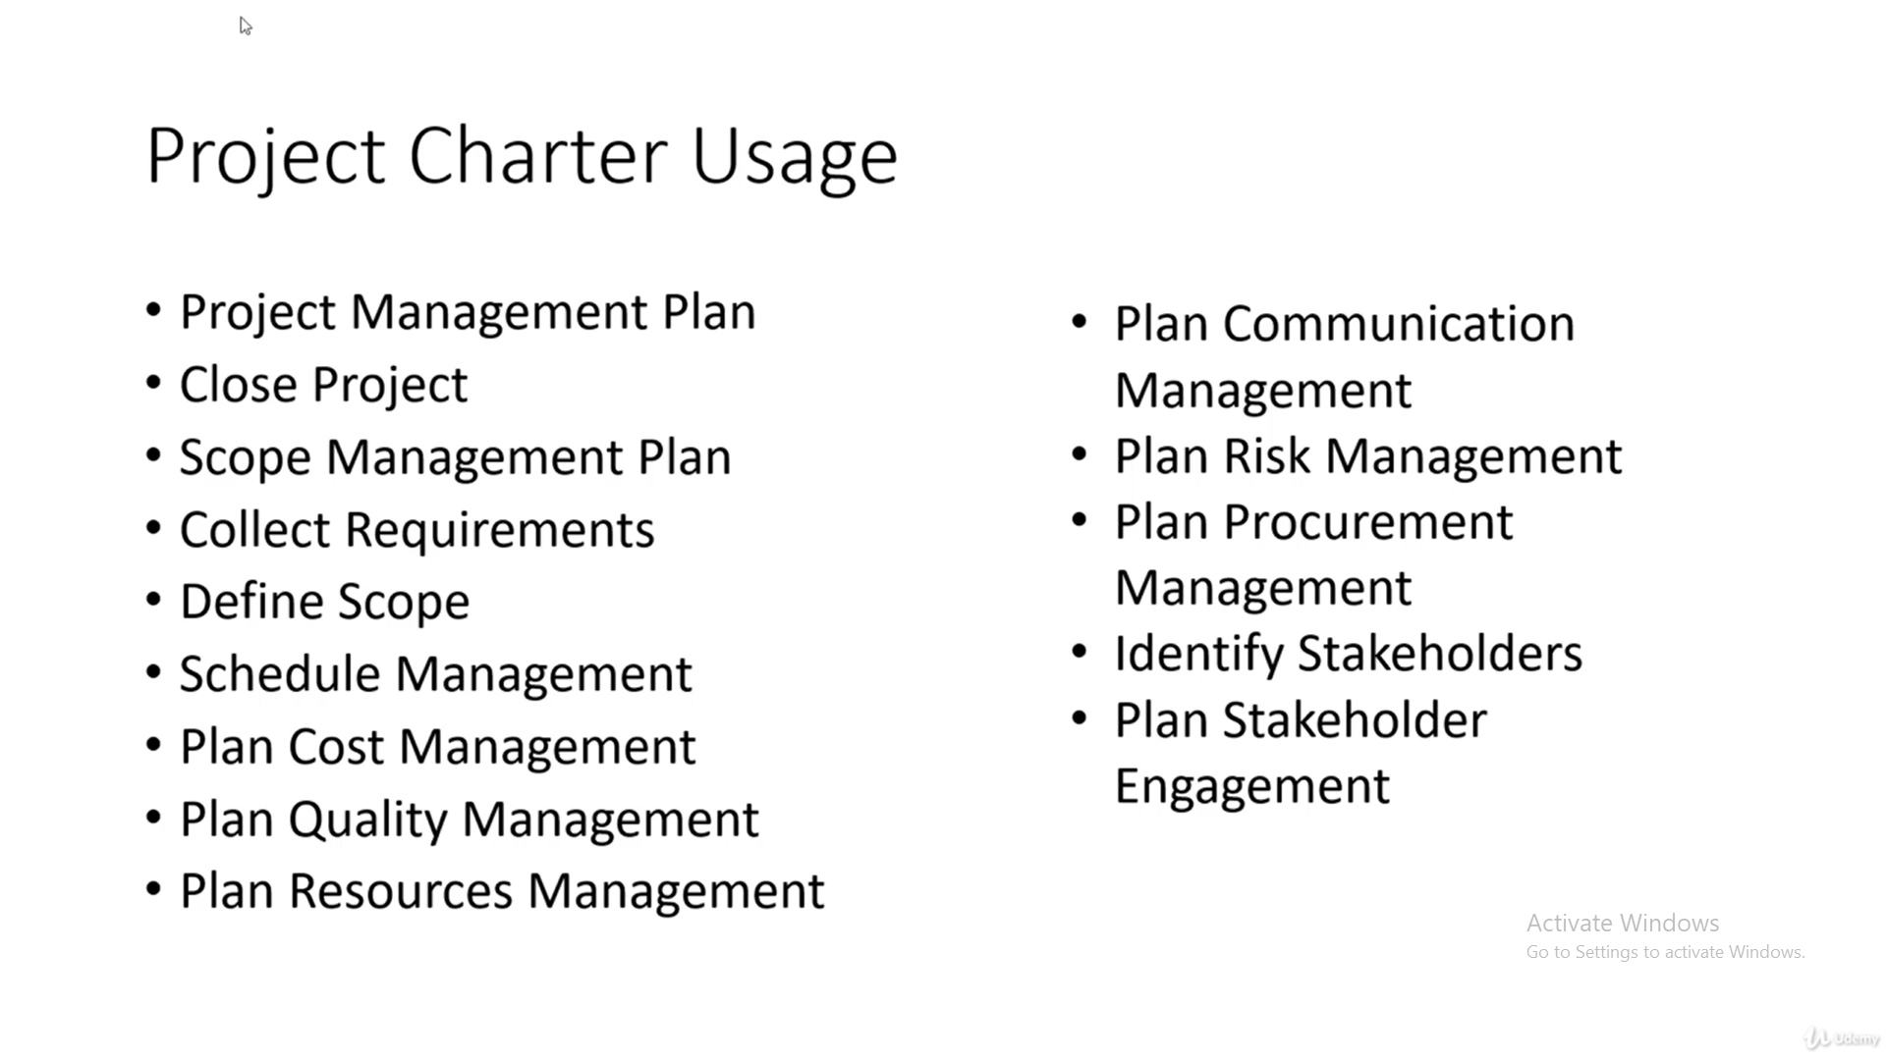

Slide 25


Slide 26


Slide 27
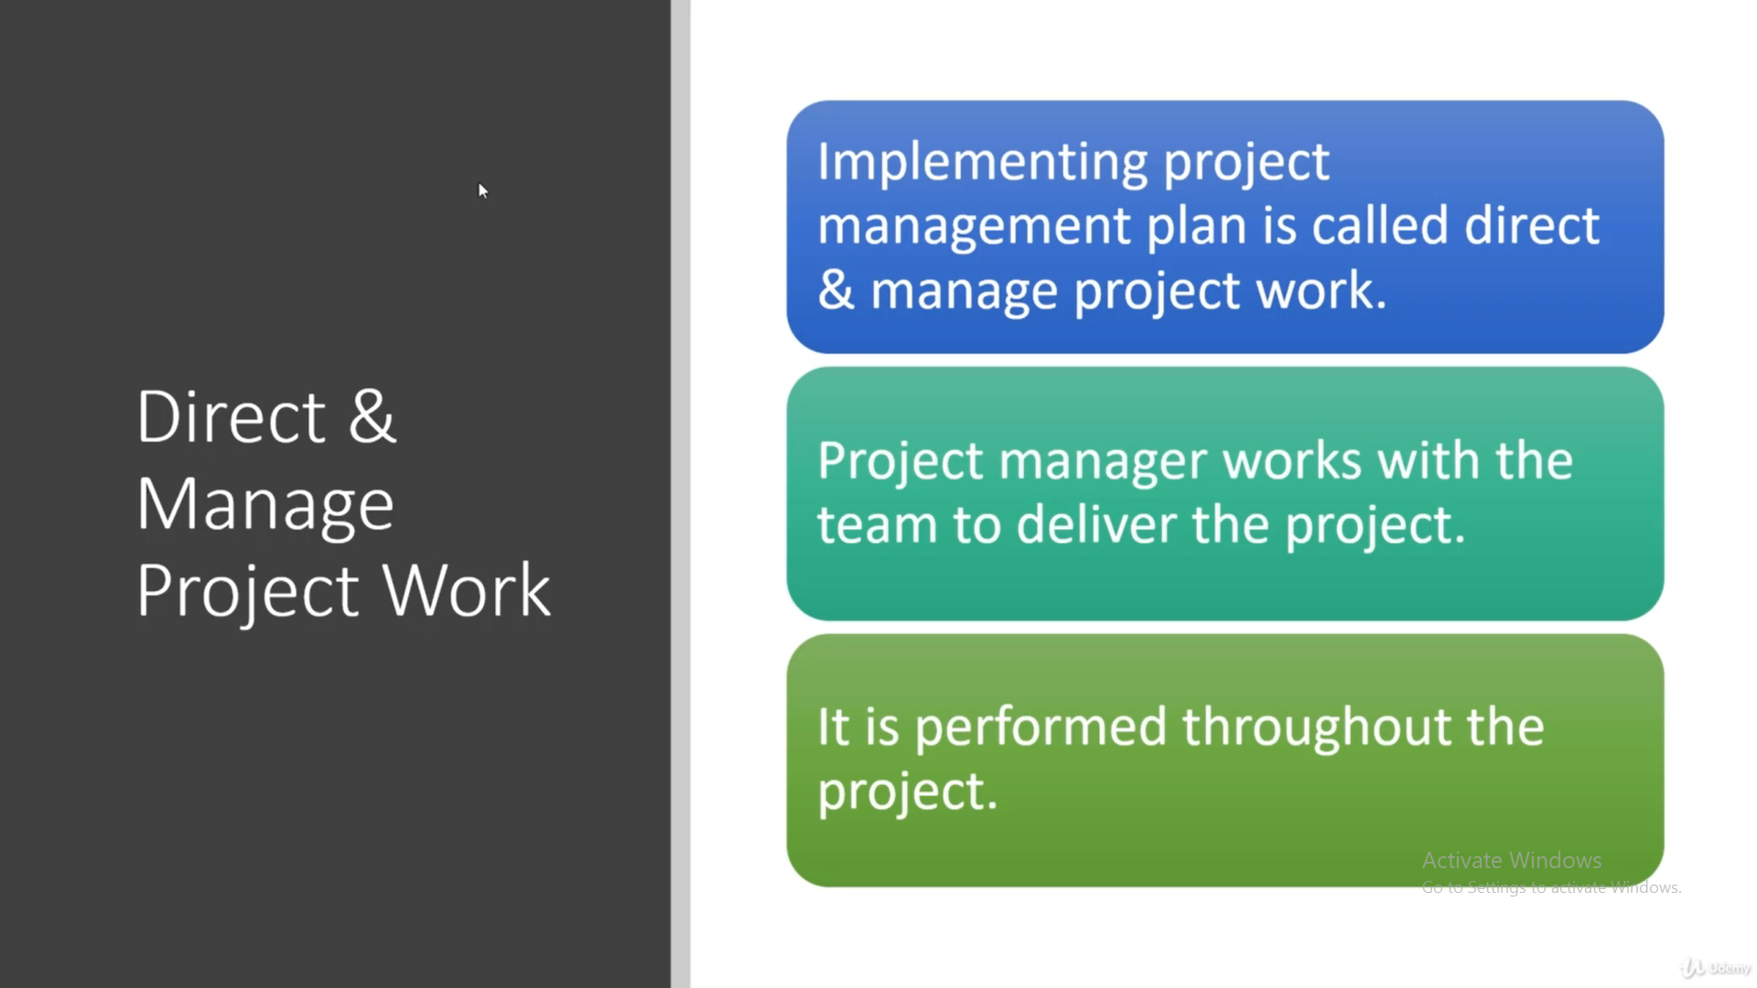

Slide 28
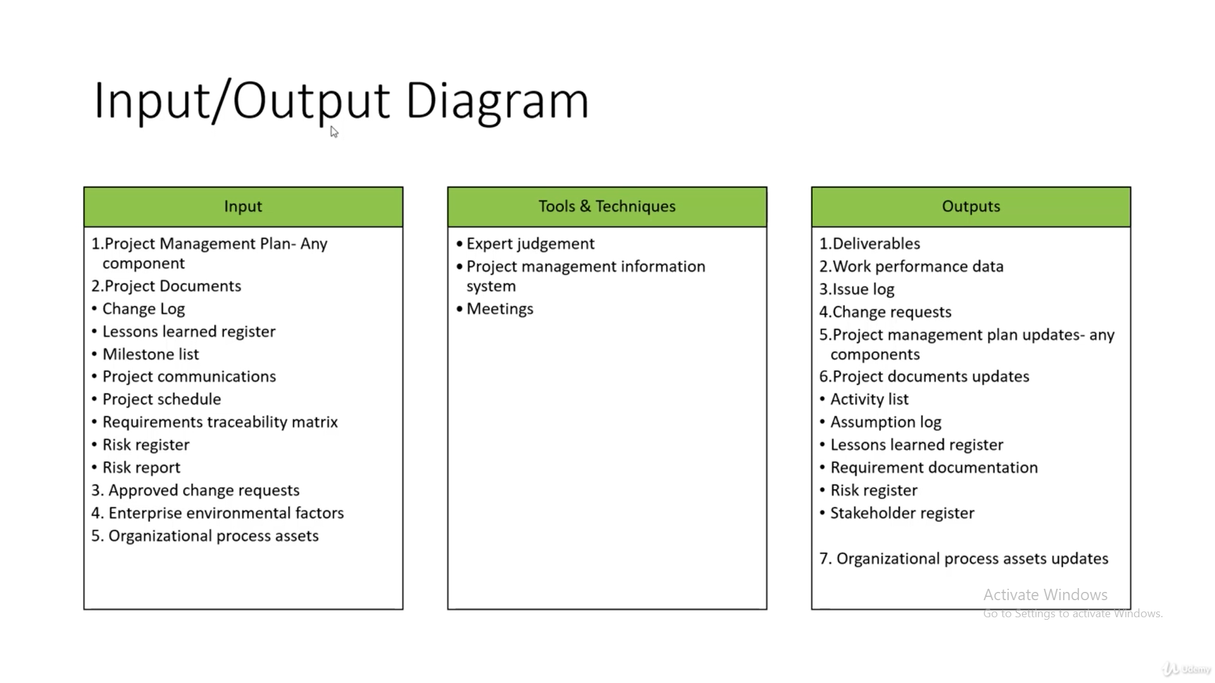

Slide 29
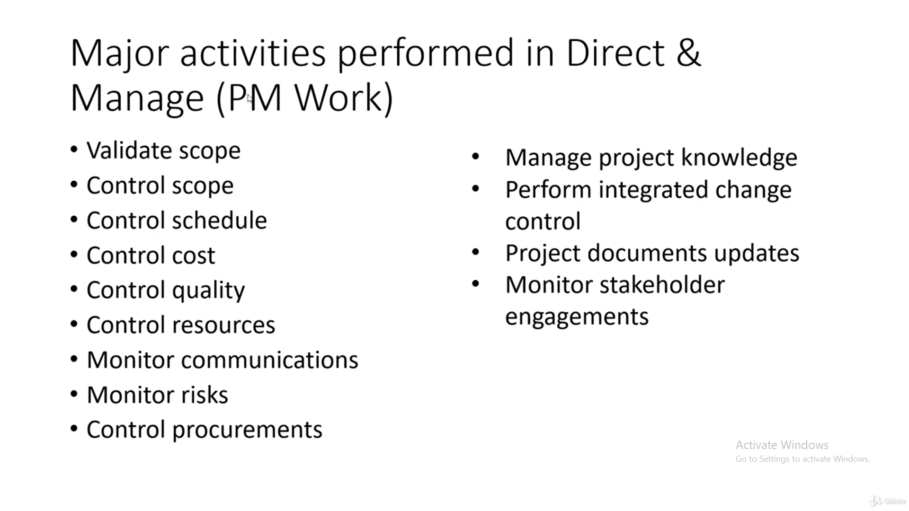

Slide 30
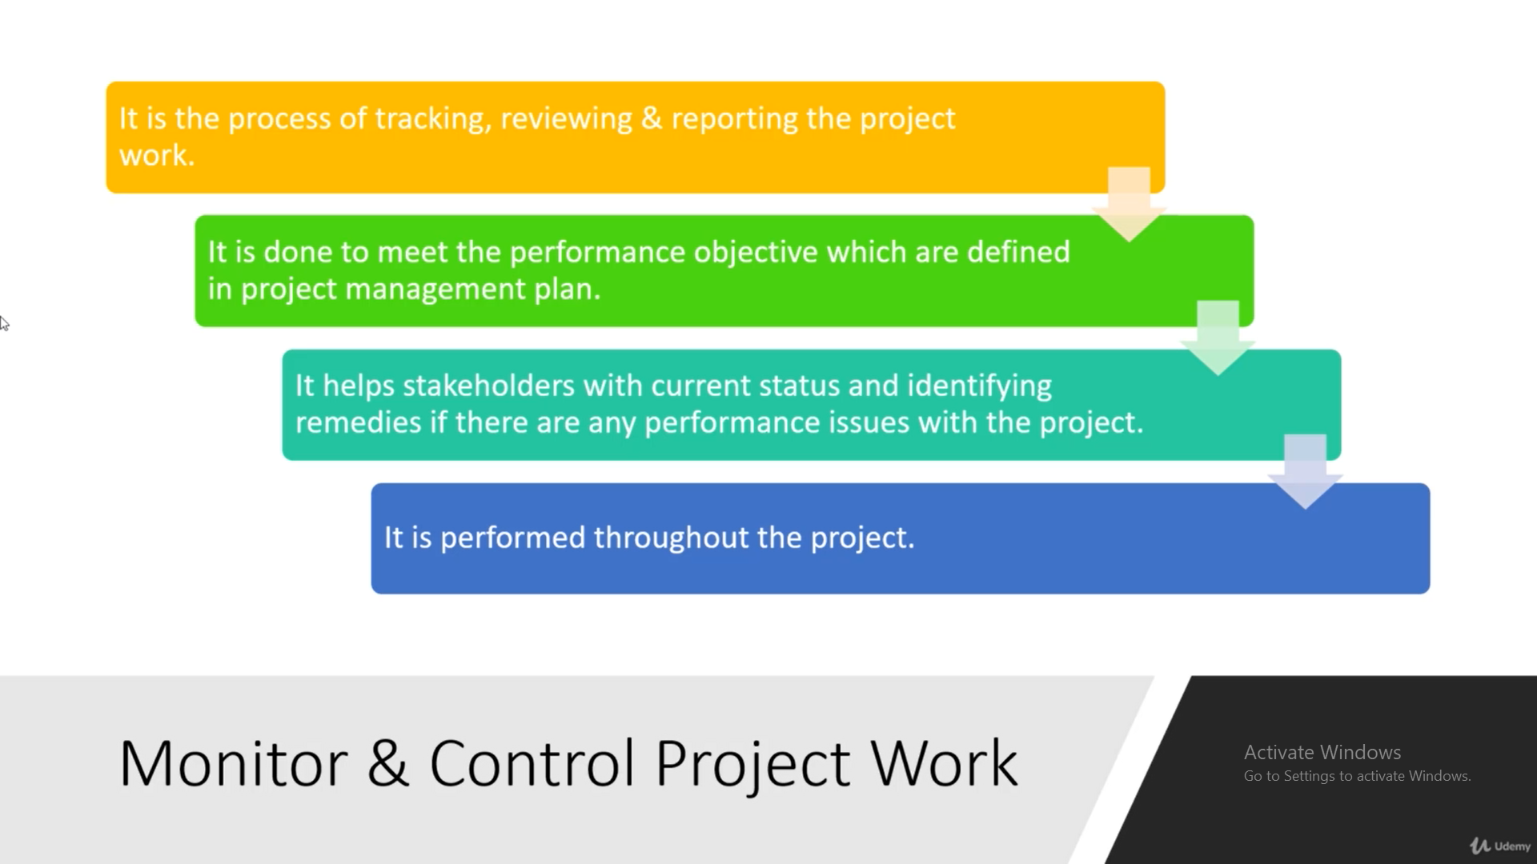

Slide 31
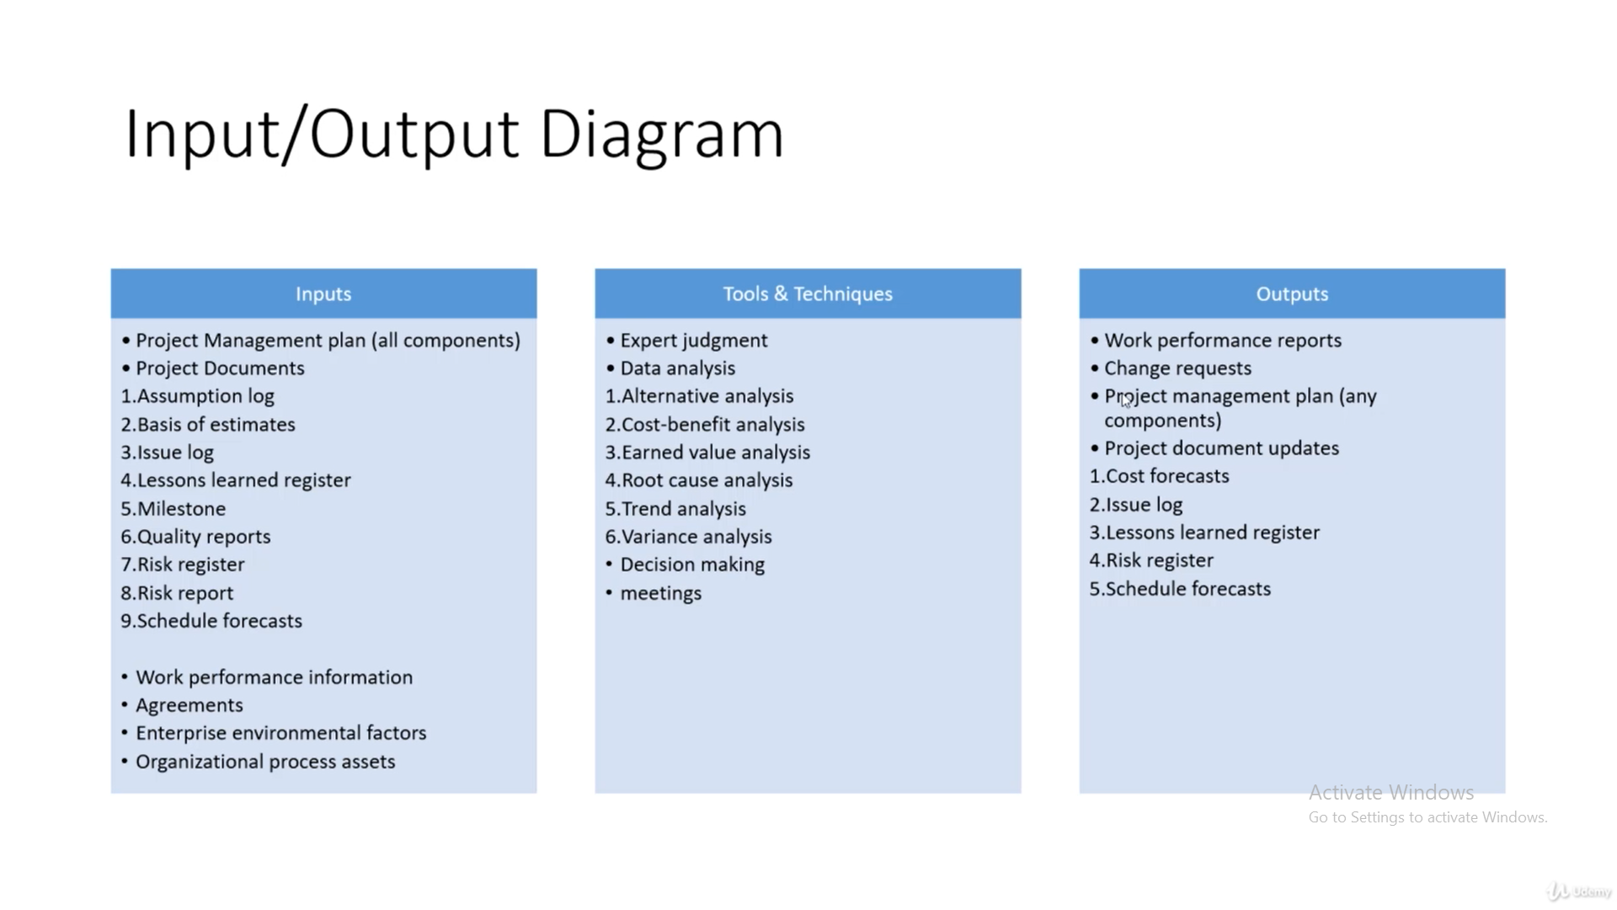

Slide 32
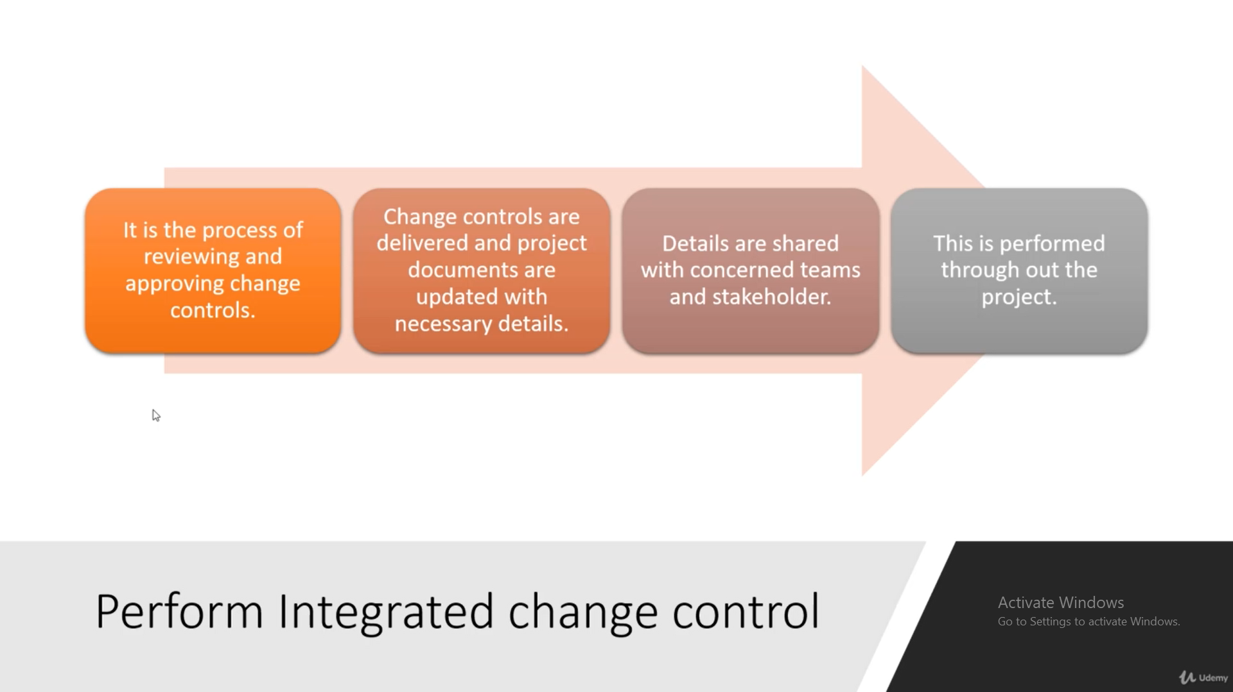

Slide 33
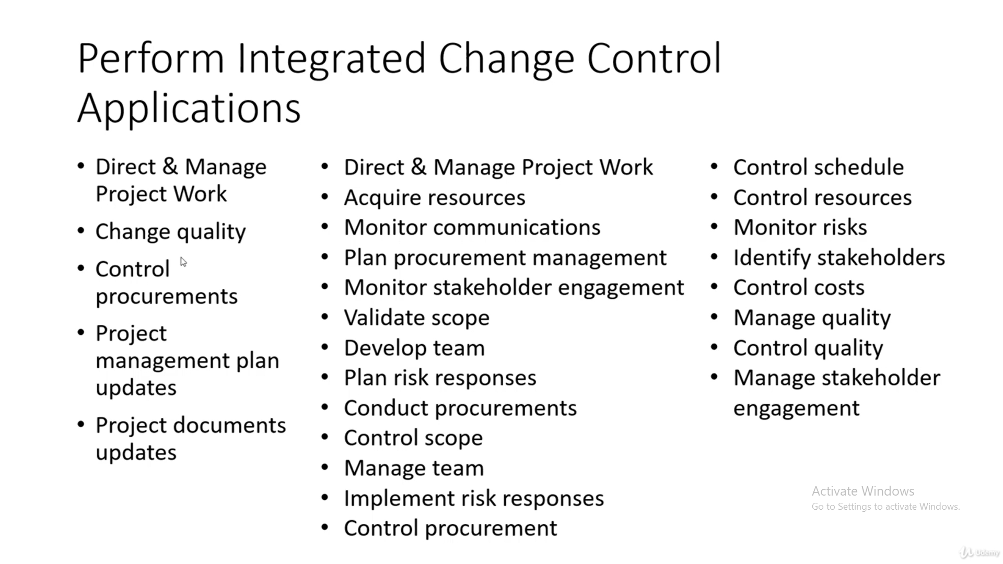

Slide 34


